Slide 1
IN THE NAME OF GOD
Urinary Retention
Z.KARIMI MD
FEMALE PELVIC MEDICINE AND RECONSTRUCTIVE SURGERY (FPMRS) FELLOWSHIP

Slide 2
Urinary Retention
the accumulation of urine in the bladder that results from incomplete or inadequate bladder emptying.
described and measured as the volume of urine left in the bladder after voiding, also known as the postvoid residual.
"an elevated postvoid residual (PVR) of >300 mL that has persisted for at least six months documented on two or more separate occasions“.
Chronic urinary retention
Acute urinary retention
Postoperative
Postpartum

Slide 3
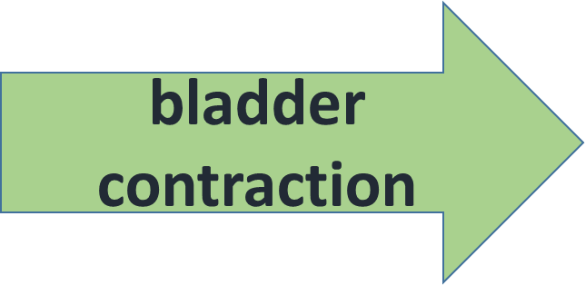
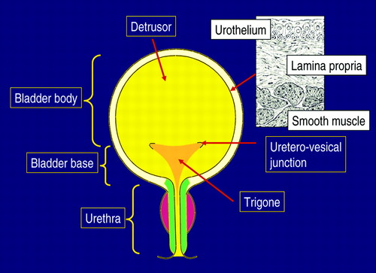
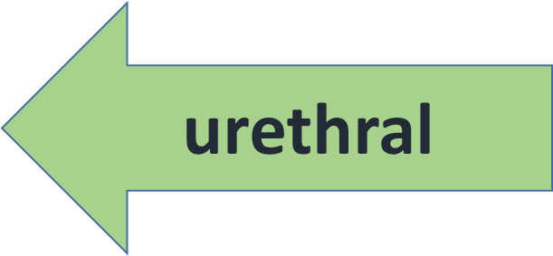
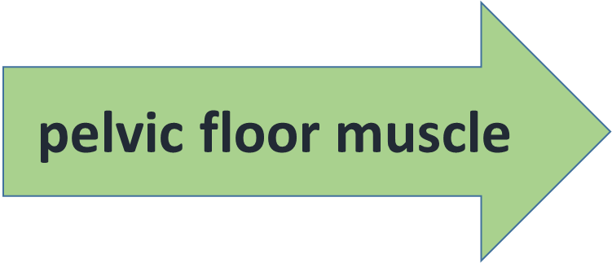
any disruption to these actions can result in urinary retention.

Slide 4
CAUSES OF URINARY RETENTION
Detrusor underactivity
Obstruction
Neurologic impairment
medications, infection, and trauma

Slide 5
Detrusor underactivity
The International Continence Society defines detrusor underactivity (DU) as a "contraction of reduced strength and/or duration, resulting in prolonged bladder emptying and/or a failure to achieve complete bladder emptying within a normal time span" .
DU represents an inability of the bladder to generate adequate contraction strength and is likely multifactorial.
The diagnosis is primarily made by urodynamic testing .
An extreme form of DU ,acontractile detrusor, is the true absence of detrusor contraction during the voiding phase of urodynamic evaluation.

Slide 6
Detrusor underactivity
Detrusor function may be affected by multiple factors, including bladder outlet obstruction, local neuropathy (both sensory and motor innervation), central nervous system disorders, ischemic changes, and bladder wall muscle changes.
Thus, common causes of DU include aging, diabetes, neurologic diseases, and medications.

Slide 7
obstruction
Bladder outlet obstruction (BOO) is defined by the International Continence Society as a "generic term for obstruction during voiding“.
It is important to note that BOO is a urodynamic diagnosis and not always accompanied by CUR or elevated PVR.
BOO in women is subdivided by cause into :
anatomic (mechanical factors )
functional (dynamic factors )

Slide 8
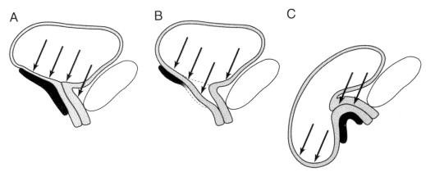
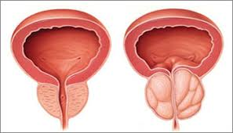
Urethral distortion
External urethral compression
Intrinsic urethral lesions

Slide 9
Anatomic
Anatomic causes are generally more obvious than functional causes and are often suspected by the patient's history, such as a prior history of anti-incontinence surgery
Urethral distortion — Pelvic organ prolapse may cause lower urinary tract anatomic distortion including urethral kinking, which can then result in impaired urine flow and an elevated PVR
prolapse beyond the hymen independently predicted urinary retention, defined as a PVR >150 mL.
In a different study, reduction of the prolapse with a pessary resolved the urinary obstruction in 17 of 18 women with prolapse beyond the hymen

Slide 10
External urethral compression
Any process that compresses the urethra may impair urine flow and result in BOO. Biologic causes include fibroids, constipation, and malignancy.
A common iatrogenic cause is a previous suburethral anti-incontinence sling.
Fibroids may cause urethral compression by displacing the cervix and subsequently compressing the urethra or bladder neck. An alternate mechanism may be local pressure on the pelvic nerve plexus that causes a radiculopathy at the S1-S2 nerve roots.

Slide 11
Intrinsic urethral lesions
Urethral lesions such as strictures, urethral diverticula, and caruncles can cause urethral blockage. Urethral strictures are typically caused by previous urethral or periurethral surgery or from previous dilation. Idiopathic urethral strictures can also occur but are less common.
Urethral diverticulum and Skene's glands infrequently cause outlet obstruction, representing 1 to 3 percent of the cases of outlet obstruction in two large reviews .Urethral cancer is rare and represents 1 percent of all malignancies, but may present with obstructive symptoms

Slide 12
Functional
Functional obstruction is caused by :
abnormal contraction of the periurethral muscle (dysfunctional voiding [DV] or detrusor sphincter dyssynergia)
failure of urethral relaxation(Fowler's syndrome)
failure of pelvic floor muscle relaxation, or failure of bladder neck relaxation (primary bladder neck obstruction)
Functional obstruction requires urodynamic evaluation for diagnosis, often with videocystourethrography or electromyography.

Slide 13
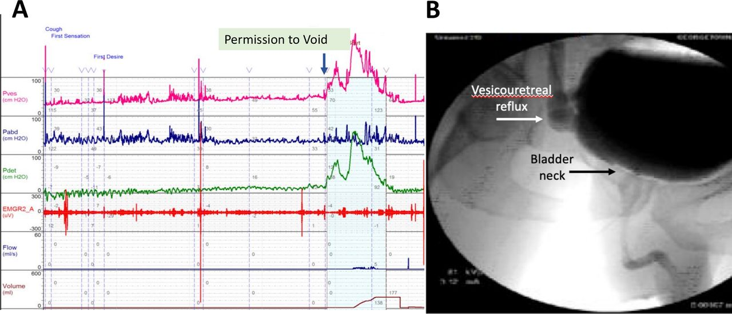

Slide 14
Neurologic impairment
AUR may develop secondary to the:
interruption of the sensory or motor nerve supply to the detrusor muscle
Incomplete relaxation of the urinary sphincter mechanism (dyssynergia) can also result in elevations in both voiding pressures and post-void residual volumes.
AUR can occur with spinal cord injuries from trauma, infarct or demyelination, epidural abscess and epidural metastasis, Guillain-Barré syndrome, diabetic neuropathy, and stroke
AUR is typically accompanied by back pain and/or other neurologic deficits. Patients with neurologic impairment may develop acute-on-chronic urinary retention.

Slide 15
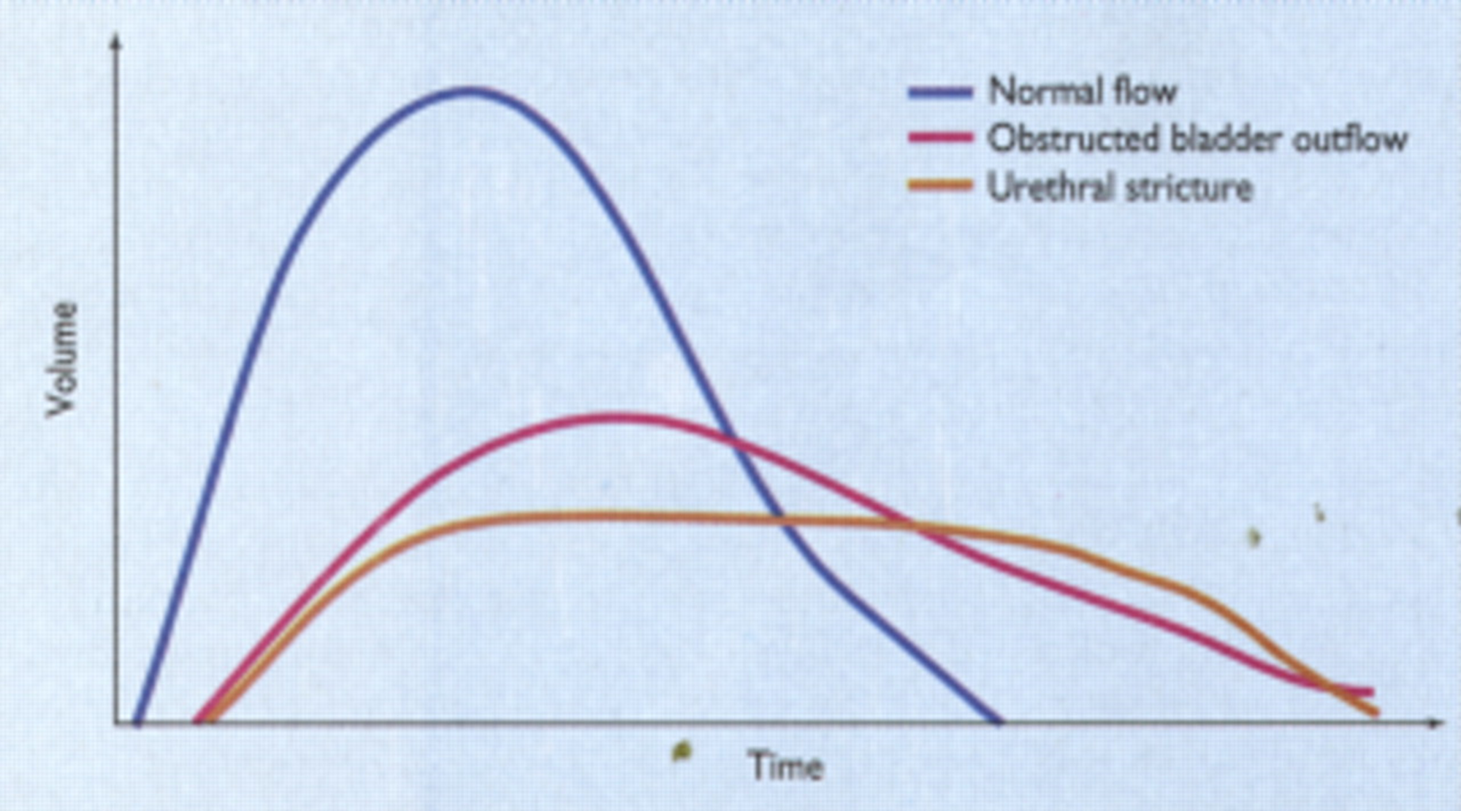
Urodynamic evaluation In addition to an elevated PVR
detrusor acontractility =
absent bladder activity + no flow or possibly intermittent urine flow from straining or increasing abdominal pressure .
DU = have low to normal flow rates+ reduced detrusor pressure (Pdet) and/or duration .
BOO =
increased detrusor pressure + reduced urine flow rates and/or prolonged urine flow time .

Slide 16
CLINICAL PRESENTATION(acute)
Women with AUR often present complaining :
inability to pass urine
associated with lower abdominal and/or suprapubic discomfort
restless and may appear in considerable distress
These manifestations may be less pronounced when AUR is superimposed upon chronic urinary retention. Chronic urinary retention is often painless.
Acute-on-chronic urinary retention may present with overflow incontinence. The patients may complain of incontinence rather than the inability to pass urine.

Slide 17
CLINICAL PRESENTATION(chronic)
Women with CUR often present complaining of partial or slow voiding or may be unable to void at all. In contrast to acute urinary retention, CUR is usually not painful.
Additional symptoms include:
Bladder sensation abnormalities: feeling of incomplete emptying or reduced urge to void
Urine stream abnormalities: slow or intermittent stream
Voiding abnormalities: hesitancy in initiating flow of urine, straining to void, and needing to splint (reduce a vaginal bulge) to start flow of urine

Slide 18
EVALUATION OF SYMPTOMS
History
previous history of retention or lower urinary tract symptoms
pelvic surgery
radiation
pelvic trauma
presence of hematuria, dysuria, fever, low back pain, neurologic symptoms, or rash.
complete list of medications
Physical examination
lower abdominal palpation , The urinary bladder may be palpable, either on abdominal or rectal examination , Deep suprapubic palpation will provoke discomfort.
Rectal examination – A rectal examination should be done in both all patients to evaluate for masses, fecal impaction, perineal sensation, and rectal sphincter tone. A normal prostate examination does not preclude benign prostatic hyperplasia (BPH) as a cause of obstruction.
Pelvic examination – Women with urinary retention should have a pelvic examination.
Neurologic evaluation – The neurologic examination should include assessment of strength, sensation, reflexes, and muscle tone.

Slide 19
Laboratory studies /Ultrasound
A urine sample should be obtained and sent for urinalysis and urine culture.
serum chemistries and creatinine checked. These should be checked in any patient whose history suggests acute-on-chronic urinary retention to evaluate for renal failure.
Other labs that may be helpful include a complete blood count (CBC) for suspected infection.
renal ultrasound for patients that meet their definition of CUR (
to evaluate for hydronephrosis/ureter may be useful in women at risk for renal damage from CUR, including those with spinal cord injury or disease, Stage 3 or 4 pelvic organ prolapse, and poor bladder compliance in the setting of high storage pressure.

Slide 20
DIAGNOSIS
ultrasound
catheterization
relatively quickly
not in extreme distress
Noninvasive , more comfortable
history and physical examination strongly suggest a diagnosis of UR
acute distress,, which is both diagnostic and therapeutic

Slide 21
catheterization
A bladder volume on ultrasound ≥300 cc suggests urinary retention warranting decompression.
However, the bladder ultrasound may be inaccurate due to body habitus, tissue edema, or prior surgery and scarring.
If the patient is in discomfort and unable to void, a urethral catheter should be placed regardless of the estimated volume on bladder ultrasound.
Upon placement of a urethral catheter, the initial amount of urine drained should be noted.
Patients with volumes <200 cc likely do not have acute urinary retention. These patients should undergo further evaluation by a urologist in an outpatient setting

Slide 22
ACUTE MANAGEMENT
The initial management of acute urinary retention (AUR) is prompt bladder decompression by catheterization, with urinalysis and culture.
An initial attempt at urethral catheterization is appropriate for most patients , particularly in patients for whom AUR is expected to resolve (eg, patients with urinary tract infections or AUR secondary to medication effect).
A 14 to 18 gauge French catheter should be inserted as first-line in most patients with AUR

Slide 23
Urethral catheterization
For patients with an initial urine volume of less than 200 cc, immediate catheter removal and subsequent observation for recurrence is usually appropriate. These patients should be evaluated for other causes of abdominal and/or suprapubic discomfort.
For patients with greater than 200 cc of urine, the volume drained in the first 10 to 15 minutes should be noted and recorded as it is useful for subsequent management regarding duration of catheter use.

Slide 24
If this volume exceeds 400 cc, the catheter is typically left in place. For volumes less than 400 cc, the decision to leave the catheter in place is guided by the clinical scenario.
For patients with greater than 200 cc and less than 400 cc, the decision on catheterization may take into account multiple factors. Patient comorbidities, mental status, ability to return to the hospital, and numerous other factors may influence this decision to leave an indwelling catheter. In patients with back pain or neurologic symptoms, the presence of spinal cord compression should be considered. Younger age, history of malignancy, or intravenous drug abuse can be associated risk factors.

Slide 25
Rate of decompression
We recommend complete drainage of the bladder in patients with AUR.
At one time, rapid complete bladder decompression was thought to increase the rate of potential complications (transient hematuria, hypotension, and postobstructive diuresis).
However, partial drainage and clamping does not reduce these complications and may increase risk for urinary tract infection

Slide 26
Complications of decompression
Hematuria : Hematuria occurs in 2 to 16 percent of patients but is rarely clinically significant . hematuria resolved with irrigation for almost all patients
Transient hypotension – After initial bladder decompression, patients may experience a transient hypotension .However, blood pressure usually normalizes without intervention and does not progress to clinically significant hypotension.
●Postobstructive diuresis – Relief of urinary tract obstruction can lead to a postobstructive diuresis, which is defined as a diuresis that persists after decompression ofthe bladder. A postobstructive diuresis is primarily a problem with chronic, not acute,urinary retention and usually represents an appropriate attempt to excrete excess fluid retained during the period of obstruction

Slide 27
Clean intermittent catheterization
CIC is associated with an increased rate of spontaneous voiding and reduction in urinary tract infections . CIC may be a reasonable option in hospitalized patients where nursing care is available and AUR is expected to resolve in a short period of time.
CIC is also a reasonable option for outpatients who are comfortable with managing the catheter and patients with acute-on chronic urinary retention who are expected to require long-term catheterization (eg, prior spinal cord injury).

Slide 28
TREATMENT OF ETIOLOGY
detrusor underactivity
Women with obstruction
clean intermittent self catheterization to periodically drain the bladder
sacral neuromodulation showed some improvement
Anatomic correction of the obstruction
Functional pelvic floor muscle training with or without biofeedback
medication
sacral neuromodulation
sphincteric injections with botulinum toxin
bladder neck incision (in select patients).

